Slide 1
Global Terrorism Analysis
Using ETL, Leaflet, Machine Learning, Django
Machine Learning used Linear Regression, Logistic Regression, Random Forest Classifier and Deep Learning Neural Network
Below are all the Tableau and ML Visualizations

Slide 2
Machine Learning
Initially we used basic methods:
Linear Regression, Logistic Regression, Random Forest
We also compared different types of Linear Regression to compare accuracy of model
We found Random Forest classifier was the most accurate among above methods
Later we checked Deep Learning Neural Network, which is as accurate as Random Forest, and both these models

Slide 3
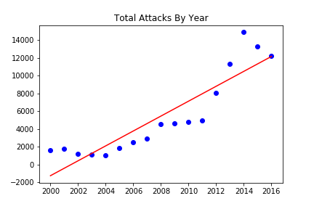
Linear Regression
Attack count vs Year
We ran this linear regression through
4 different models:
Default, Lasso, Ridge and ElasticNet.
Lasso model gave the best R2 score
of 58.44 % and lowest MSE.

Slide 4
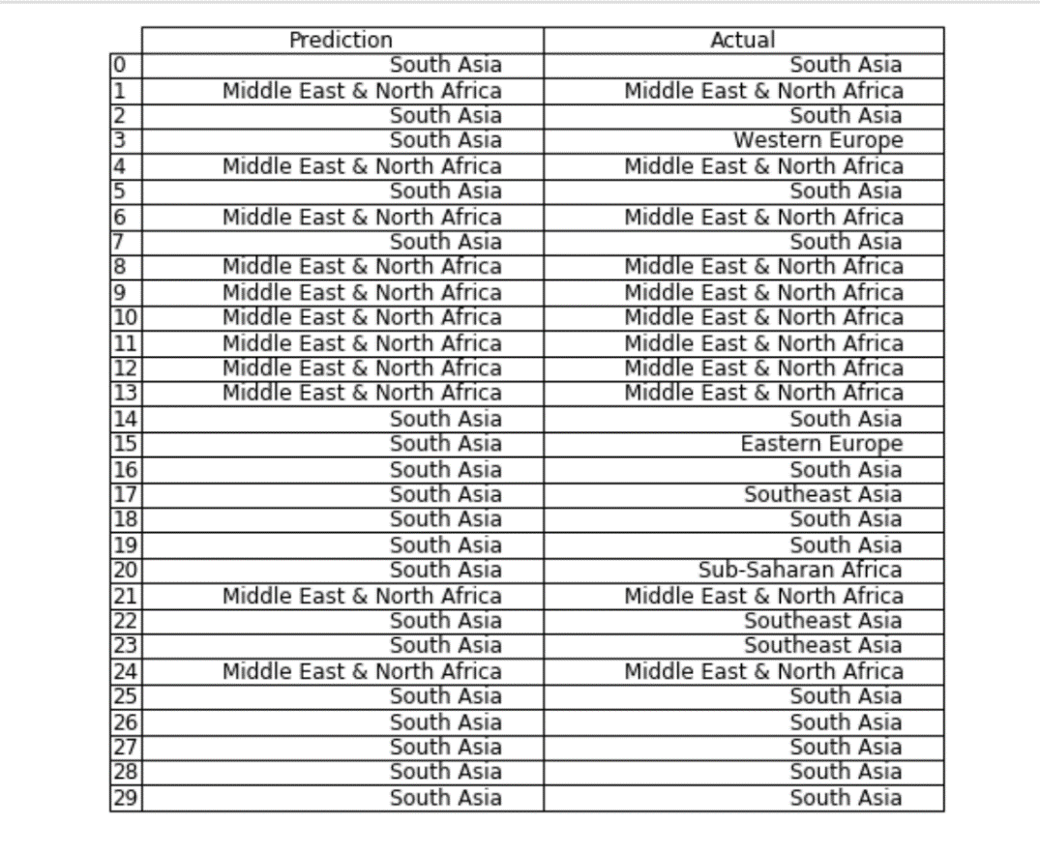
Logistic Regression
Casualties by region:
We ran a logistic regression for casualties, to try to predict the region
of next casualty, based on other numeric variables:
success, suicide, nkill, nwound, year and casualties.
Following are the results:
Training Data Score: 71.589%
Testing Data Score: 71.590%
This was the result of running the regression for 92,700 rows.
Below is a sample table of results for the top 30 rows, out of which
24 are correct predictions.

Slide 5
Machine learning algorithms
Random Forest Classifier:
A random forest is a meta estimator that fits a number of decision tree classifiers on various sub-samples of the dataset and uses averaging to improve the predictive accuracy and control over-fitting. The sub-sample size is always the same as the original input sample size but the samples are drawn with replacement if bootstrap=True (default).
Deep Learning Neural Network
A deep neural network (DNN) is an artificial neural network (ANN) with multiple layers between the input and output layers. The DNN finds the correct mathematical manipulation to turn the input into the output, whether it be a linear relationship or a non-linear relationship. The network moves through the layers calculating the probability of each output. For example, a DNN that is trained to recognize dog breeds will go over the given image and calculate the probability that the dog in the image is a certain breed. The user can review the results and select which probabilities the network should display (above a certain threshold, etc.) and return the proposed label. Each mathematical manipulation as such is considered a layer, and complex DNN have many layers, hence the name "deep" networks.
DNNs can model complex non-linear relationships. DNN architectures generate compositional models where the object is expressed as a layered composition of primitives. The extra layers enable composition of features from lower layers, potentially modeling complex data with fewer units than a similarly performing shallow network.

Slide 6
Random forest vs Deep Learning comparison
Below charts are the comparisons of 2 most accurate machine learning methods among the ones we worked.
The comparison is for number of attacks / casualties on Y-Axis and the X-axis contains different variables like Global Region, Country, Province, Attack Type and Weapon Type.

Slide 7
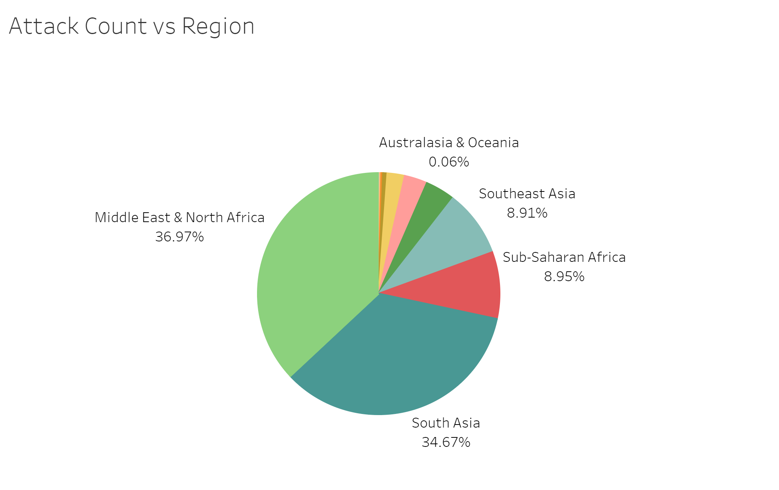
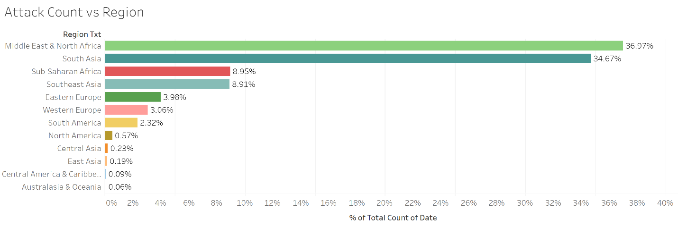
Region vs Terrorist Attacks – Past Data (Tableau)
Past data shows that Middle East and South Asia region have had most attacks. But we are doing predictions of future, and the percentages change, as seen in below slides.

Slide 8
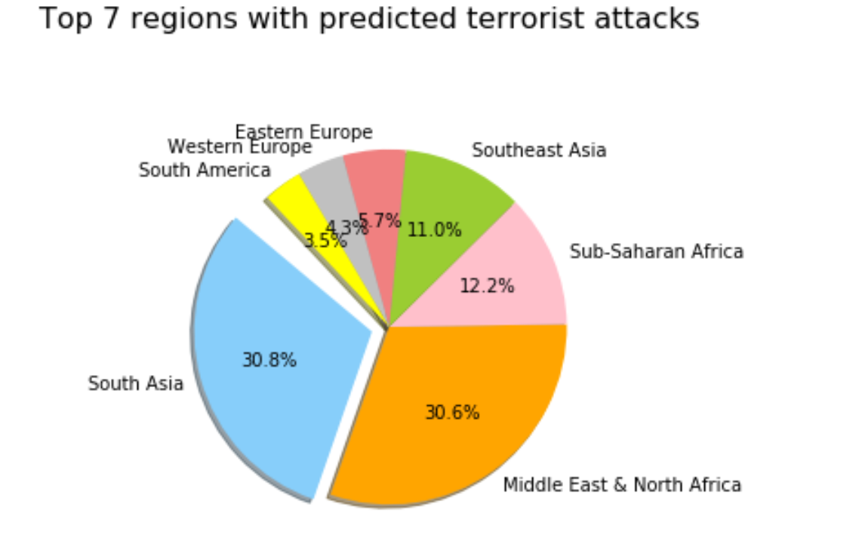
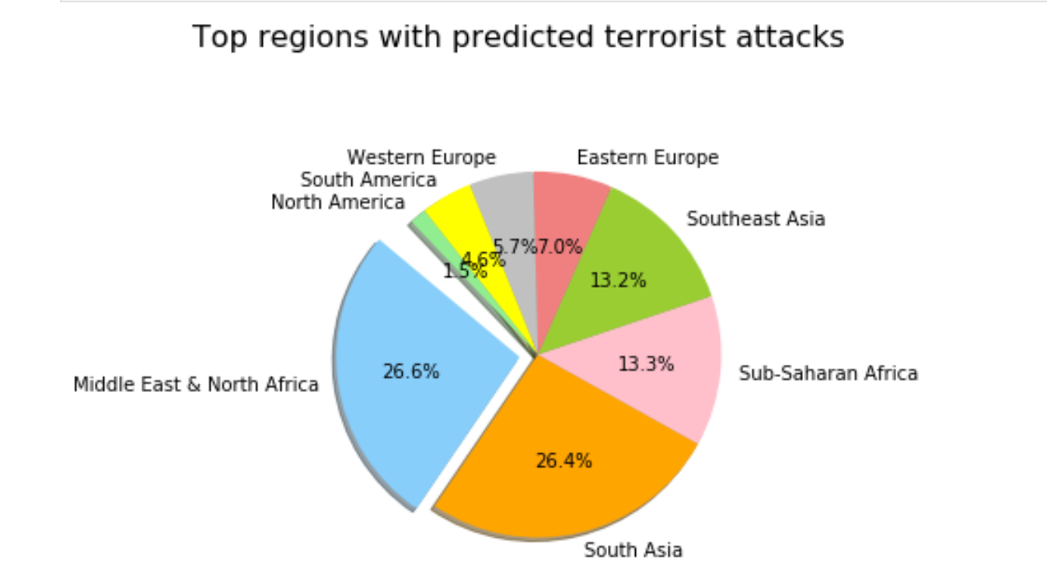
Predict Region with next terrorist attack
Random Forest – 100%
Deep Learning Neural Network – 99.93%
Using Random Forest method, South Asia is predicted as number 1 region for future.

Slide 9
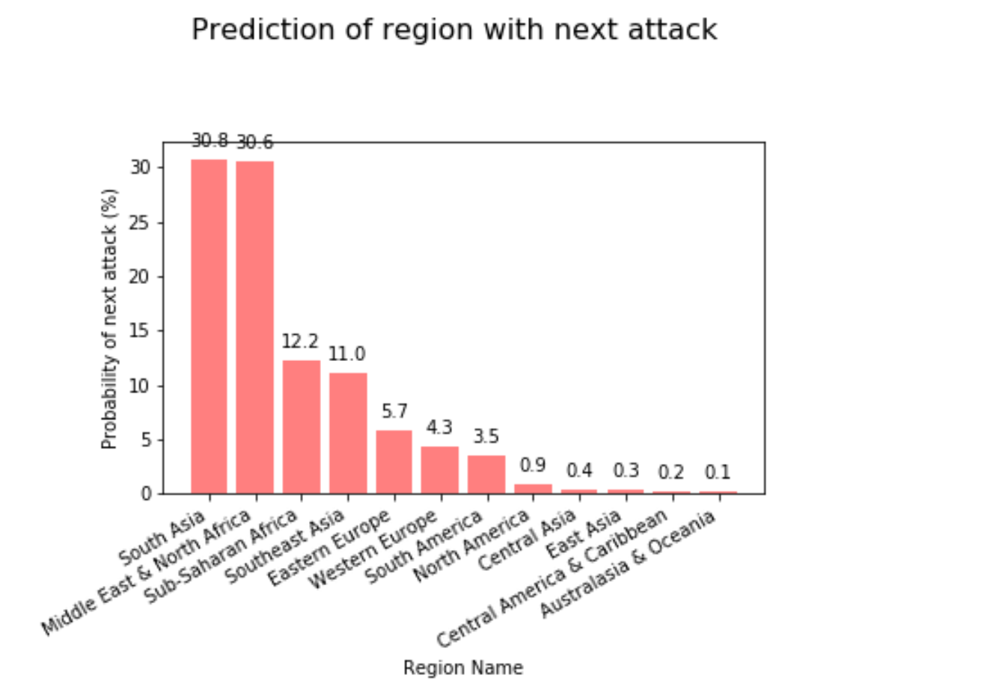
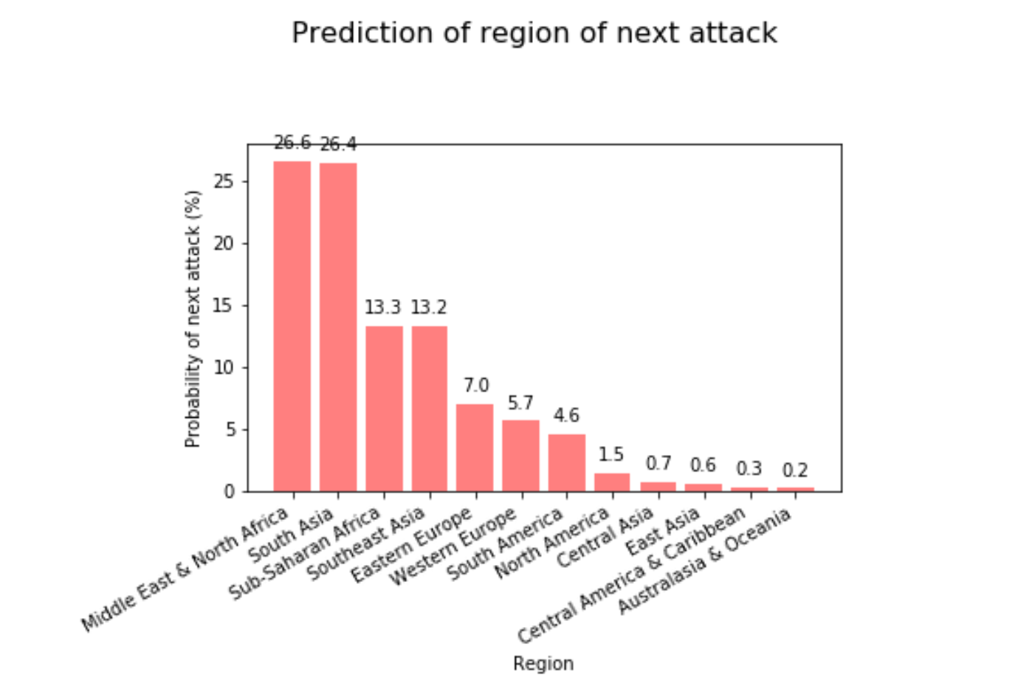
Region vs Attack Prediction - Bar
Random Forest Bar Chart
Deep Learning Bar Chart
Although Australasia & Oceania is only at 0.1 or 0.2 % using two different methods, one of the major attacks this year took place in New Zealand. This shows that either more factors like security vulnerability, happiness etc. are needed to analyze.

Slide 10
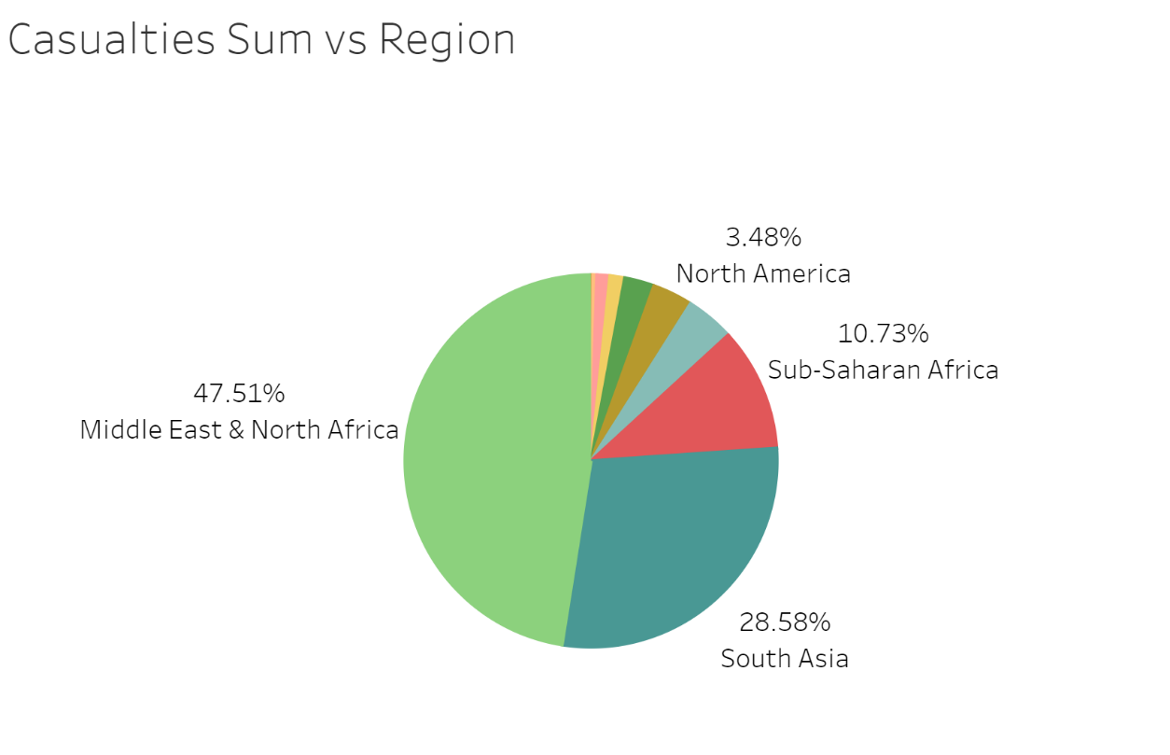
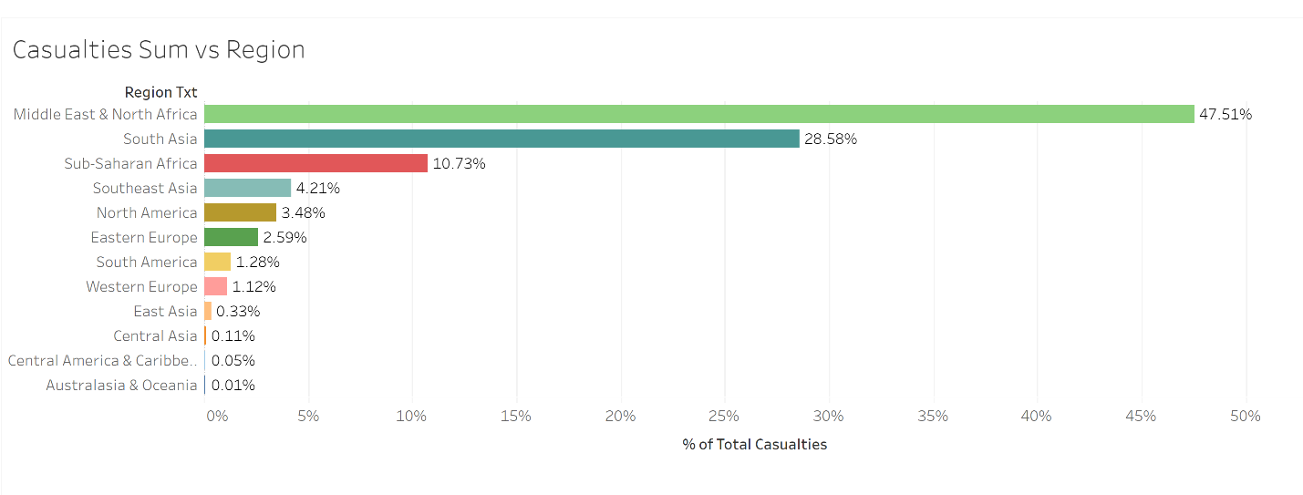
Region vs Casualties – Past Data (Tableau)

Slide 11
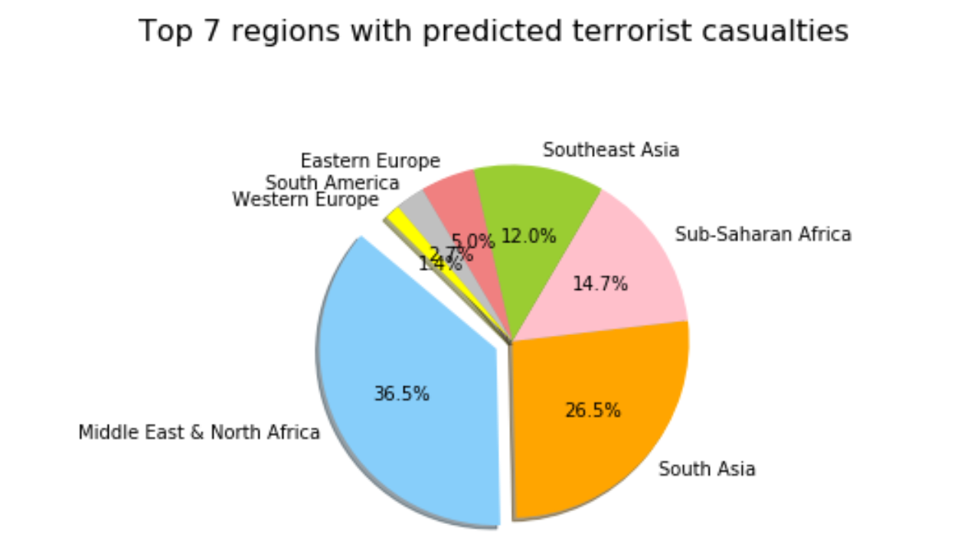
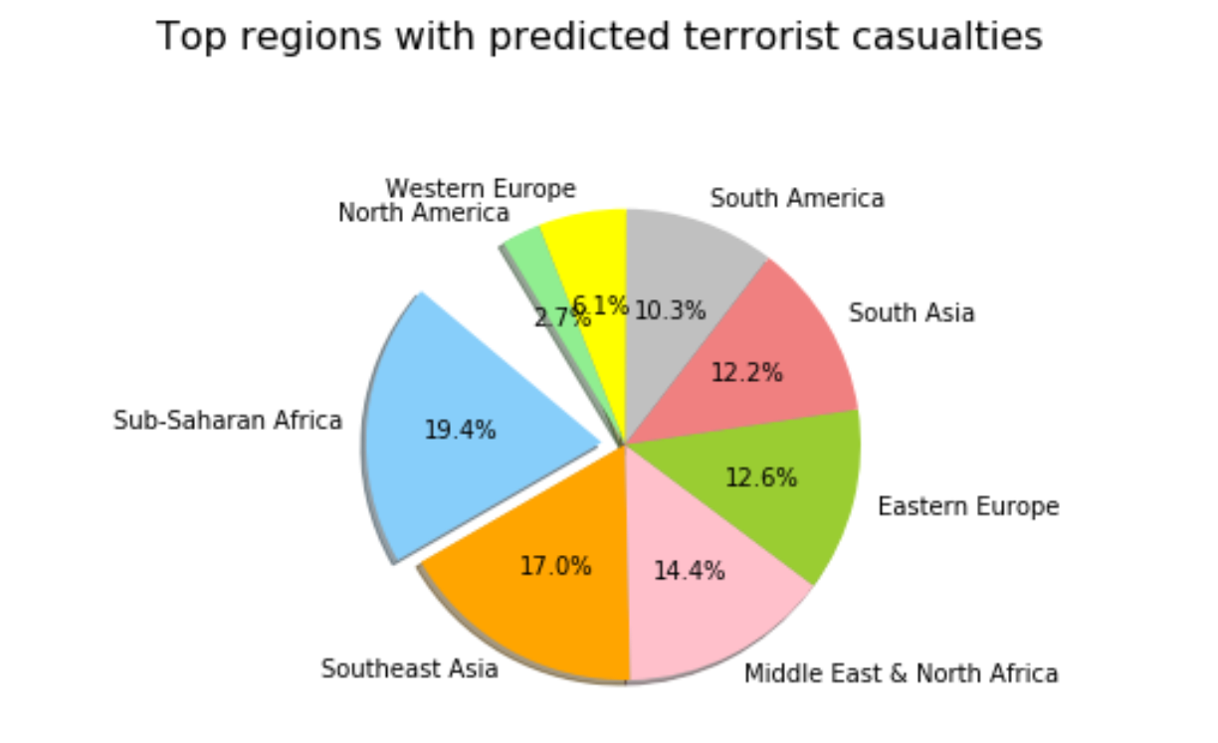
Casualties vs Region Prediction - Pie
Random Forest – 79.81%
Deep Learning – 79.79%
The above pie charts show the difference in 2 algorithms. Deep Learning method shows higher percentages for regions such as
Western Europe, South America, North America compared to Random Forest, while Random forest percentages are closer to
Tableau percentage of past data.

Slide 12
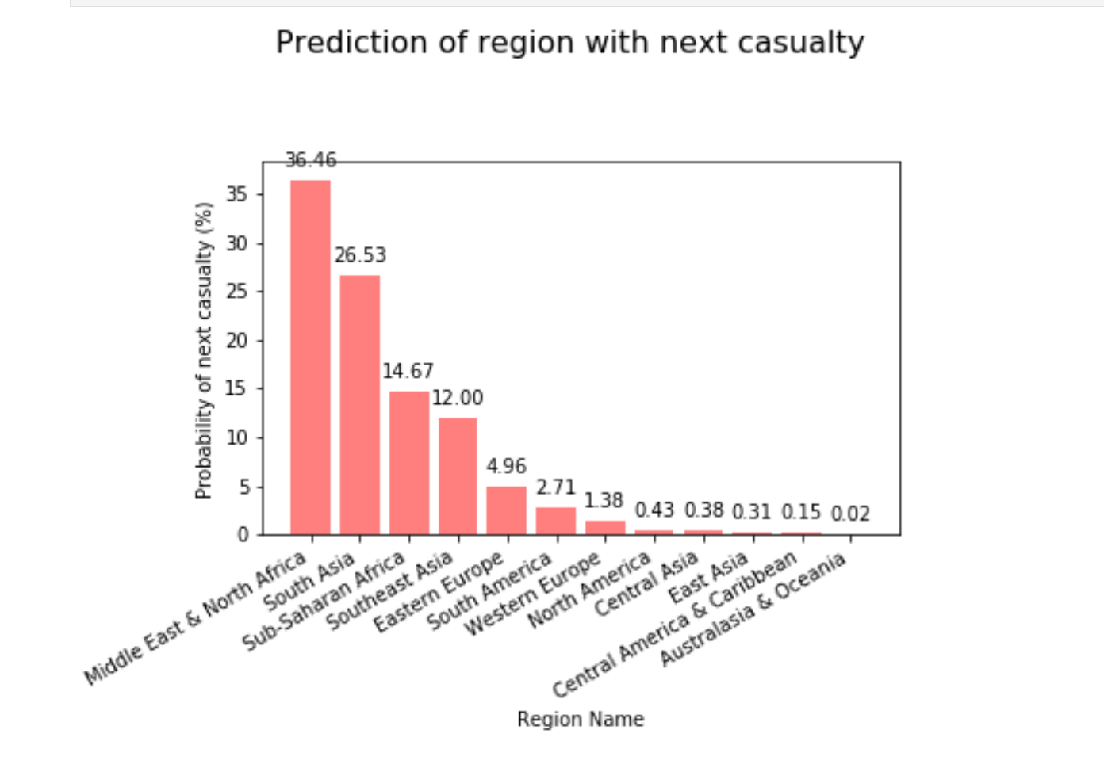
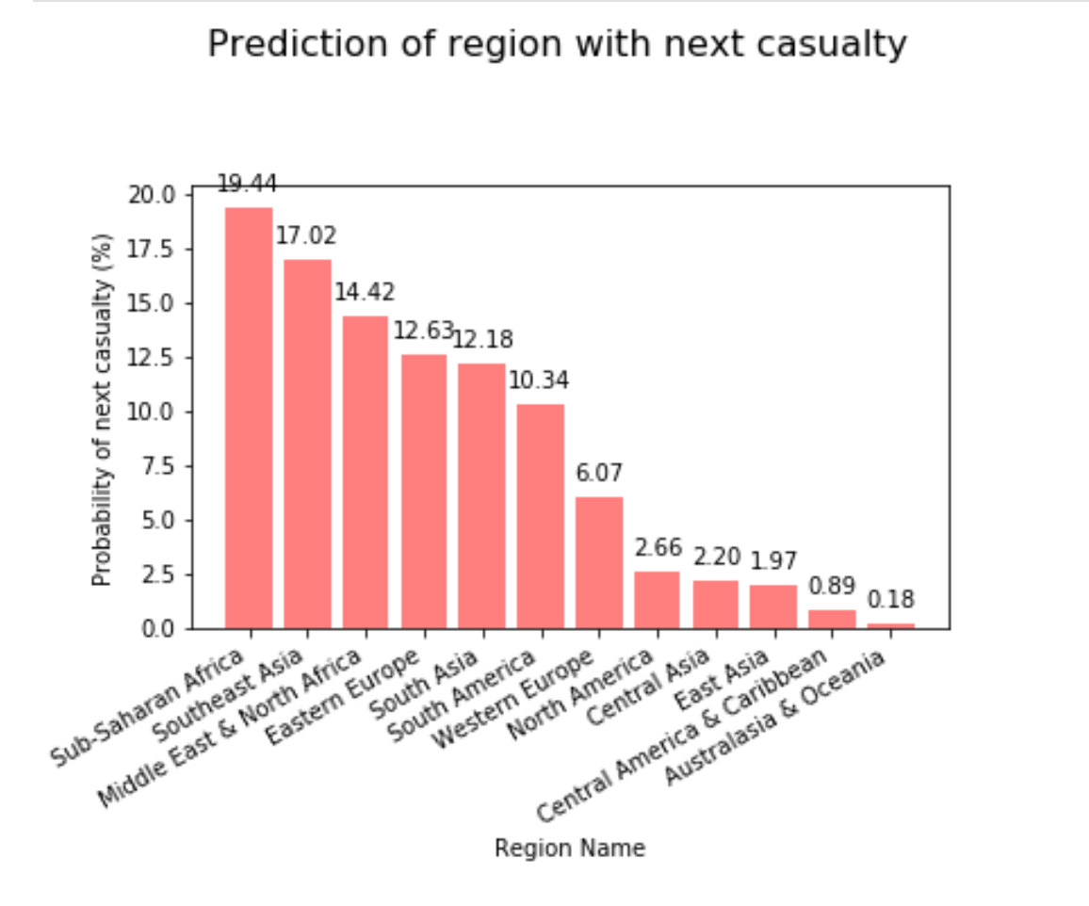
Region vs Casualties prediction - bar
Random Forest
Deep Learning

Slide 13
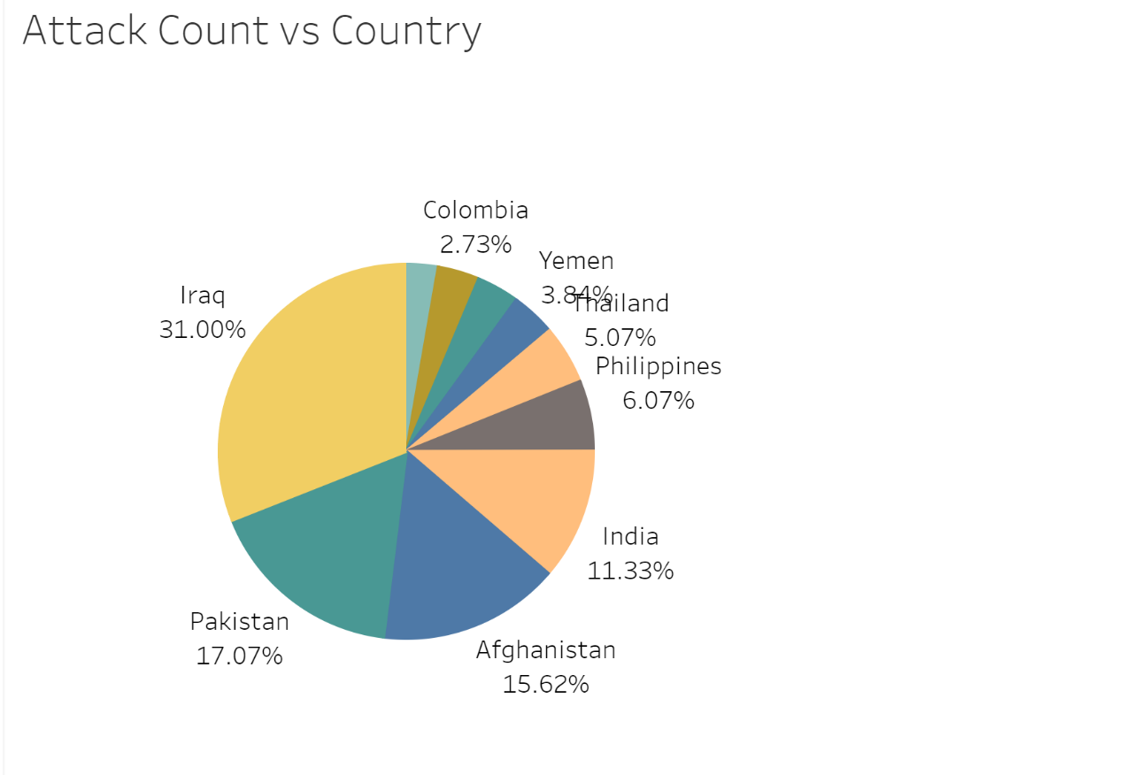
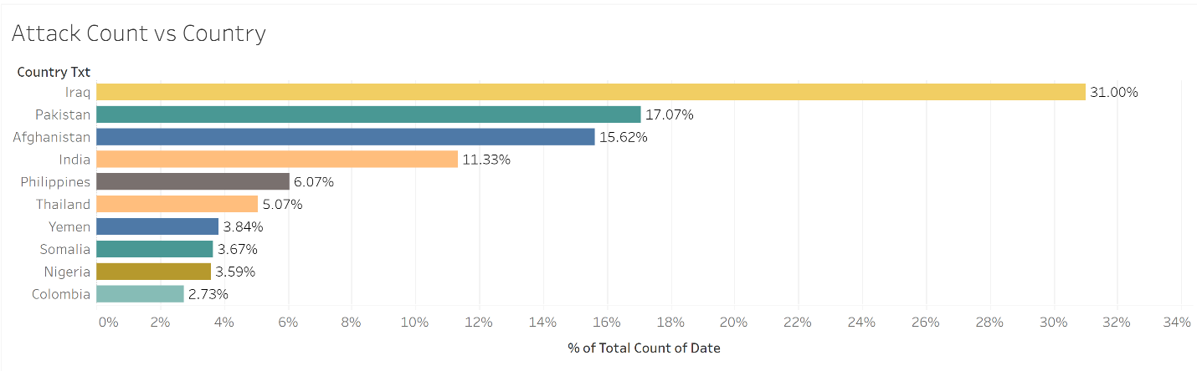
Country vs Attacks – Past Data (Tableau)

Slide 14
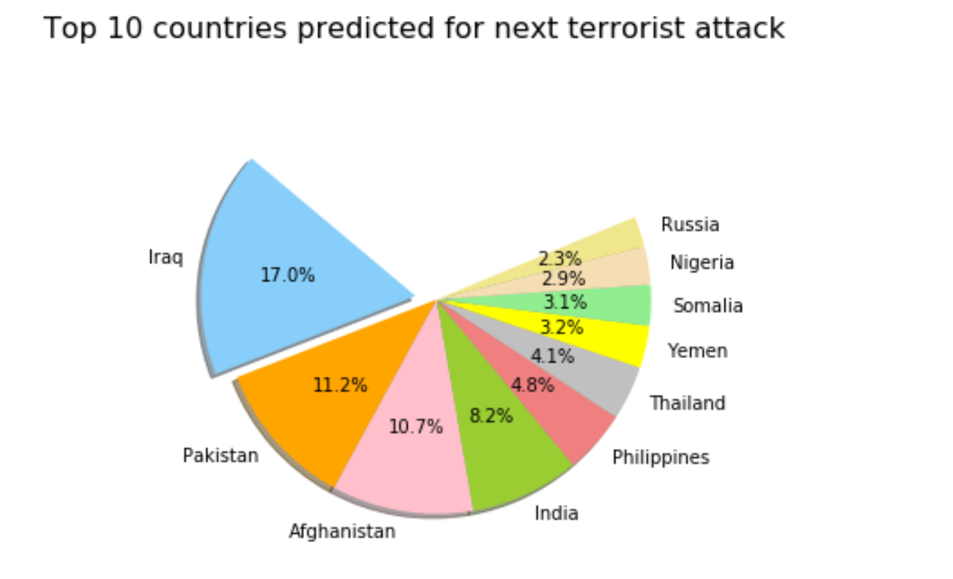
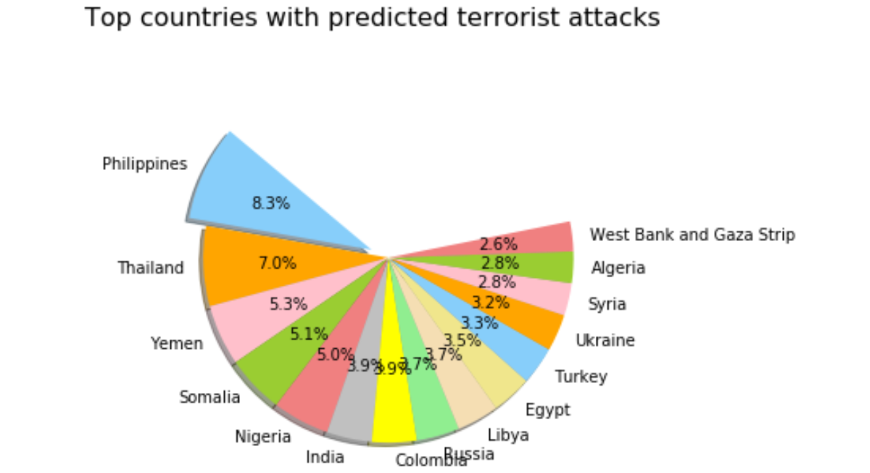
Country vs Attack - Prediction
Random Forest – 99.96%
Deep Learning – 99.98%
As there are more than 160 countries, the percentages in the 2 models are quite different from
each other as well as from Tableau.

Slide 15
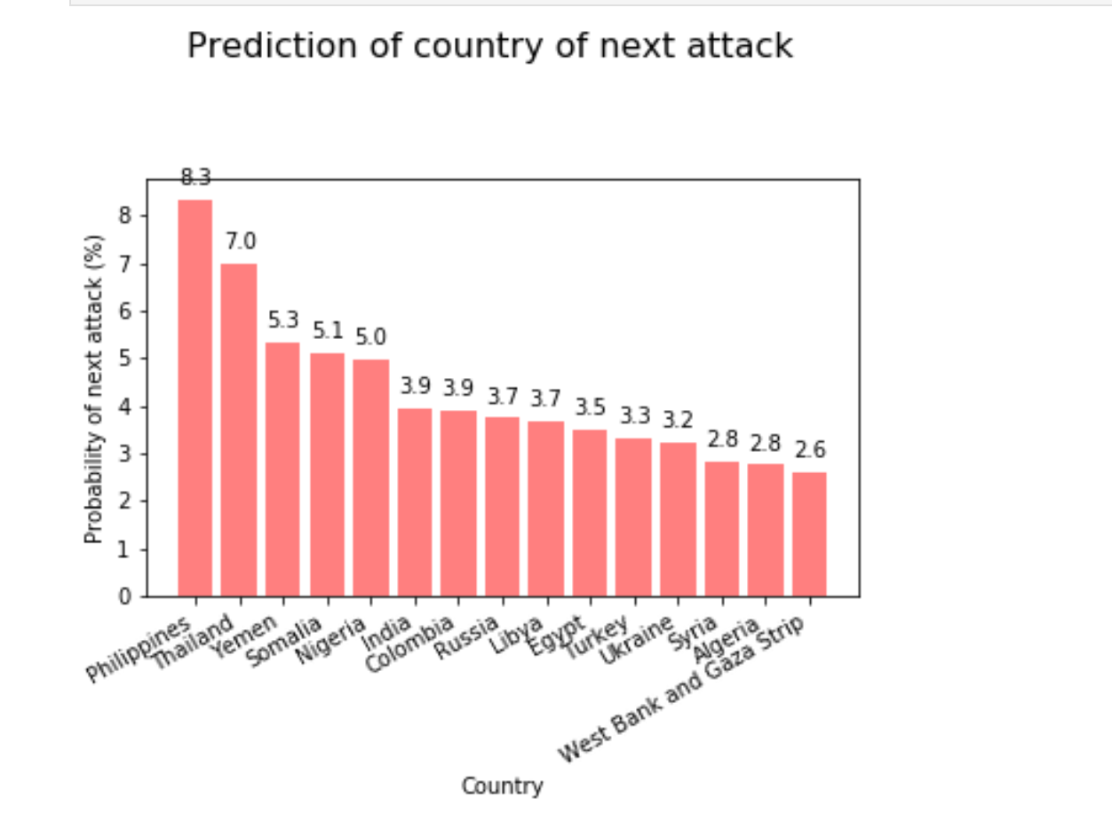
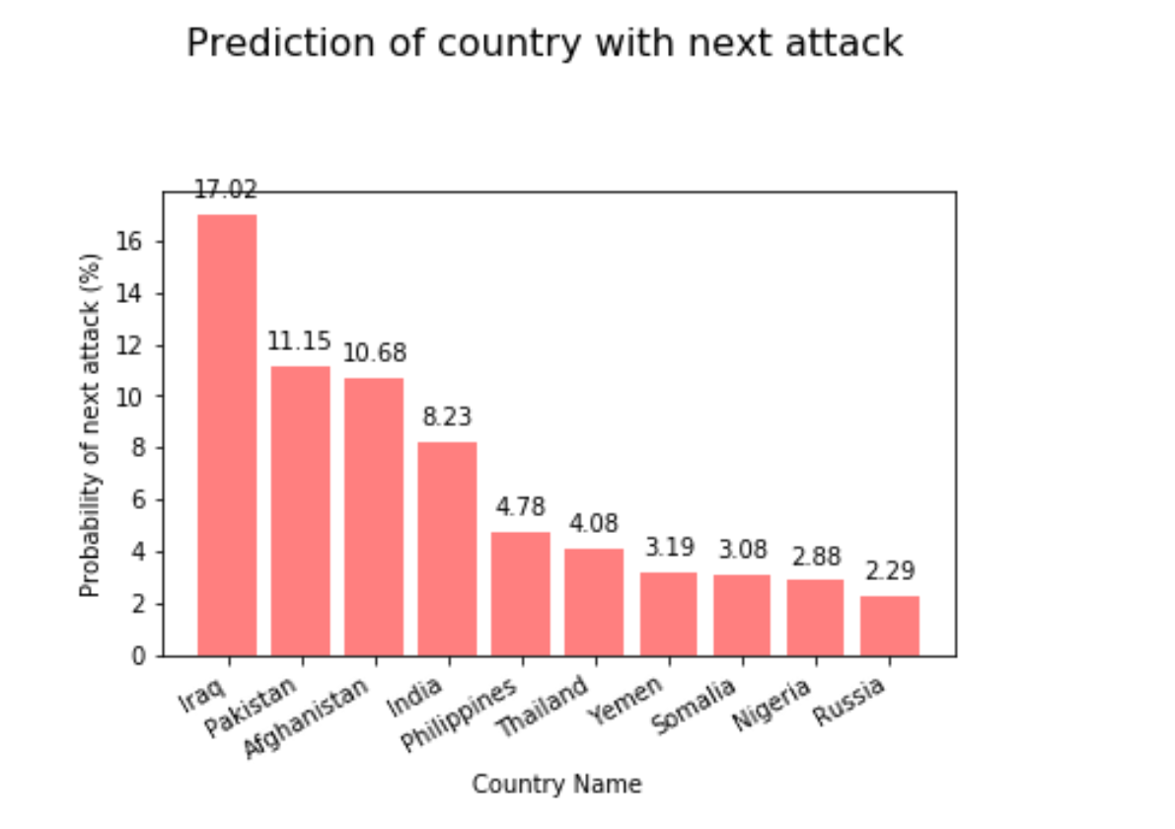
Country vs Attack Prediction- Bar
Random Forest
Deep Learning

Slide 16
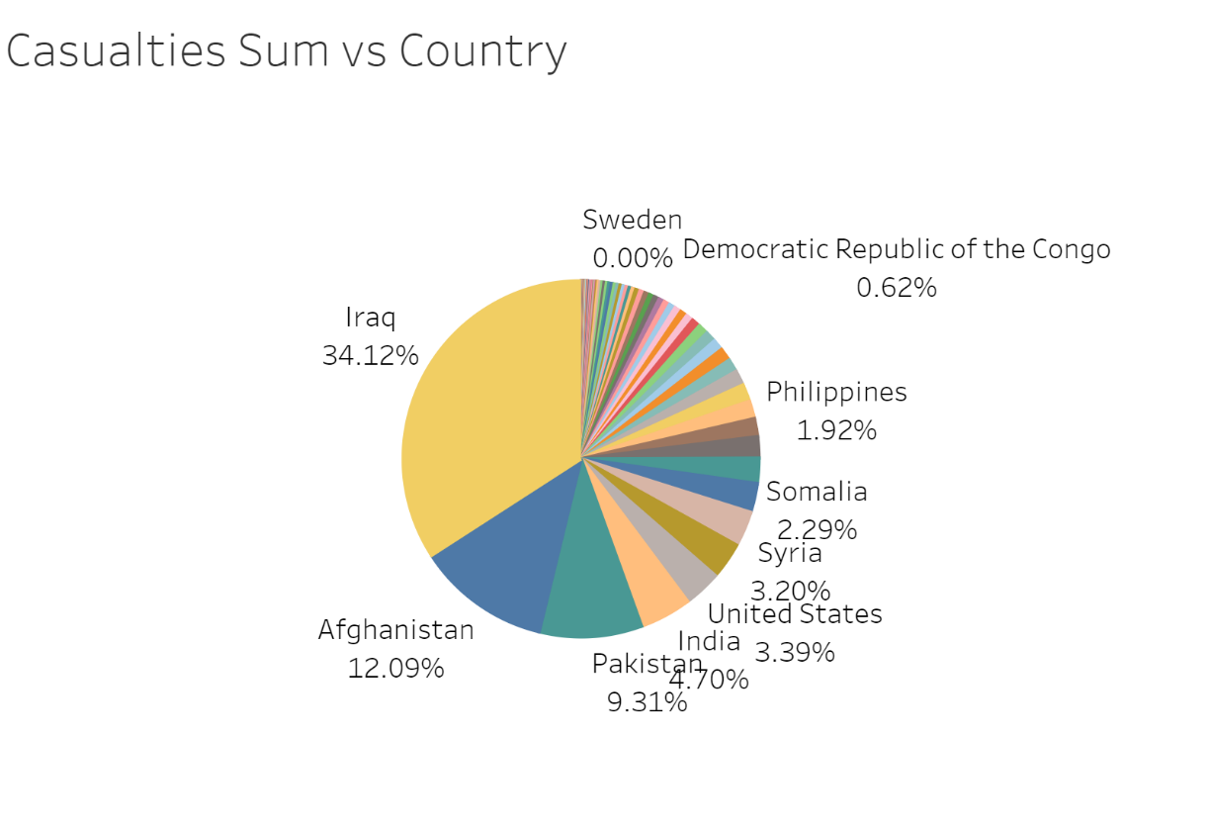
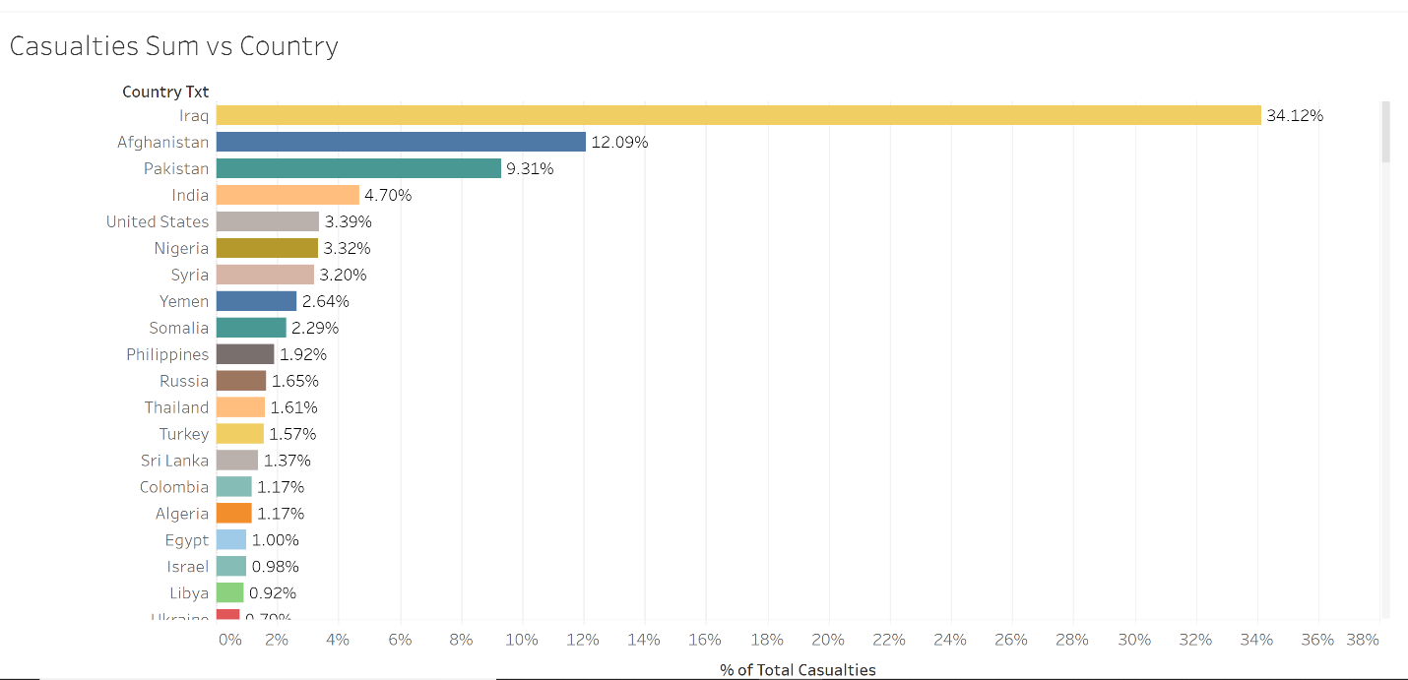
Country vs Casualties – Past Data (Tableau)

Slide 17
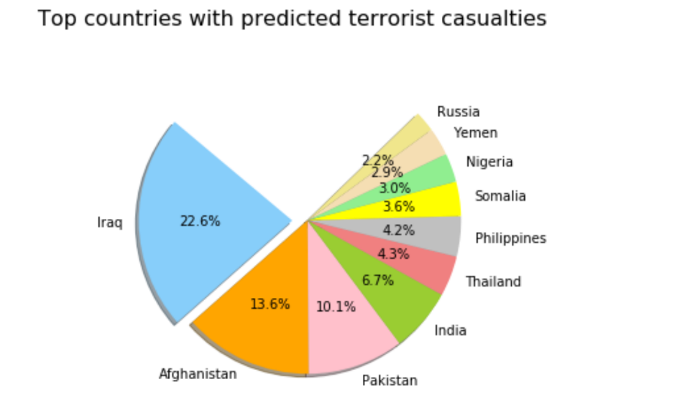
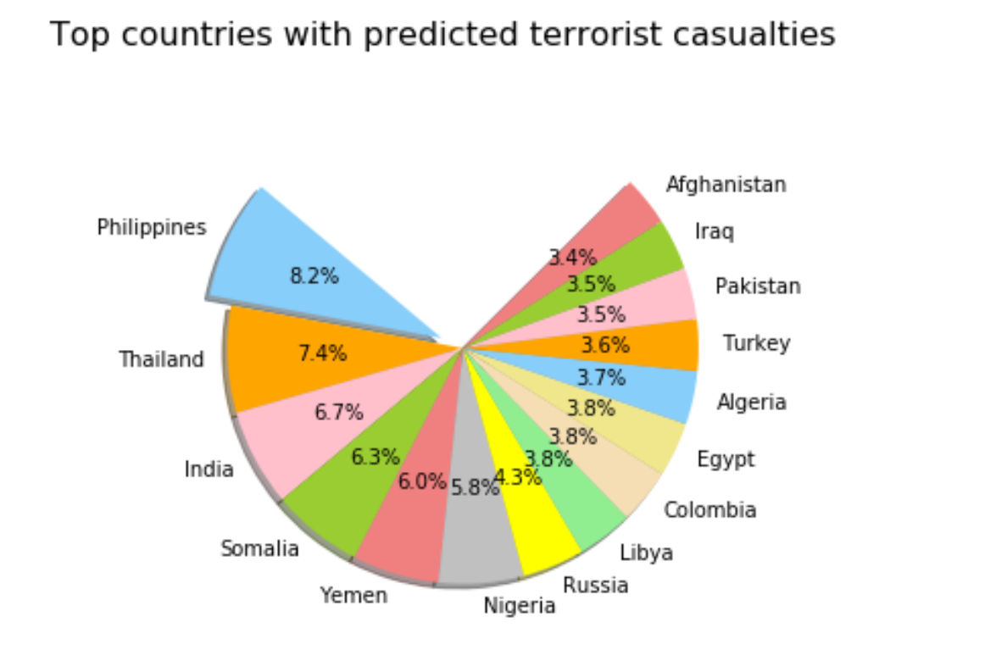
Country vs Casualties Prediction
Random Forest – 72.88%
Deep Learning – 72.24%
As seen above, the pies for Country vs Casualties are similar to the Country vs Attacks pies above.
But the 2 methods show different values and order of countries.

Slide 18
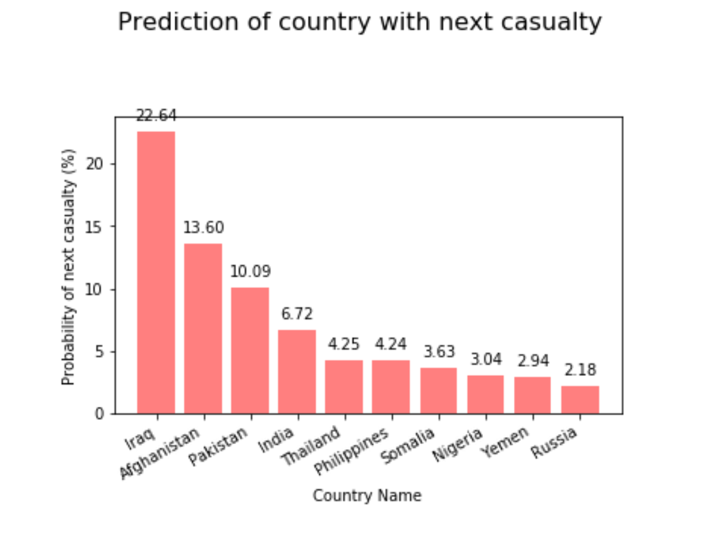
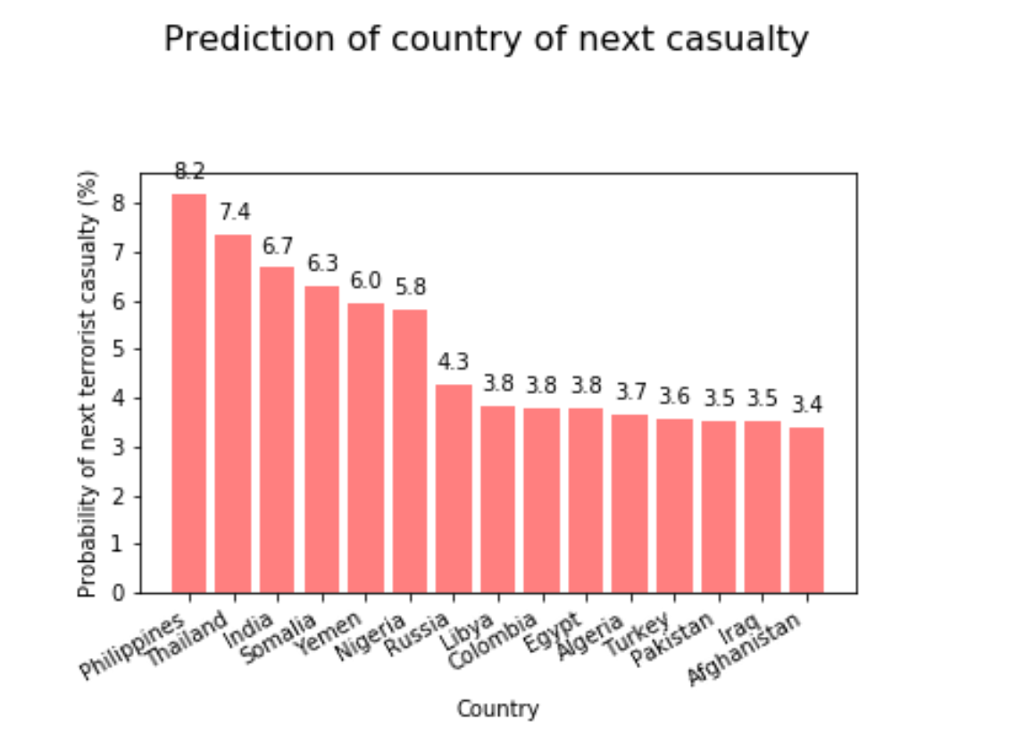
Country vs Casualties – Bar
Random Forest
Deep Learning

Slide 19
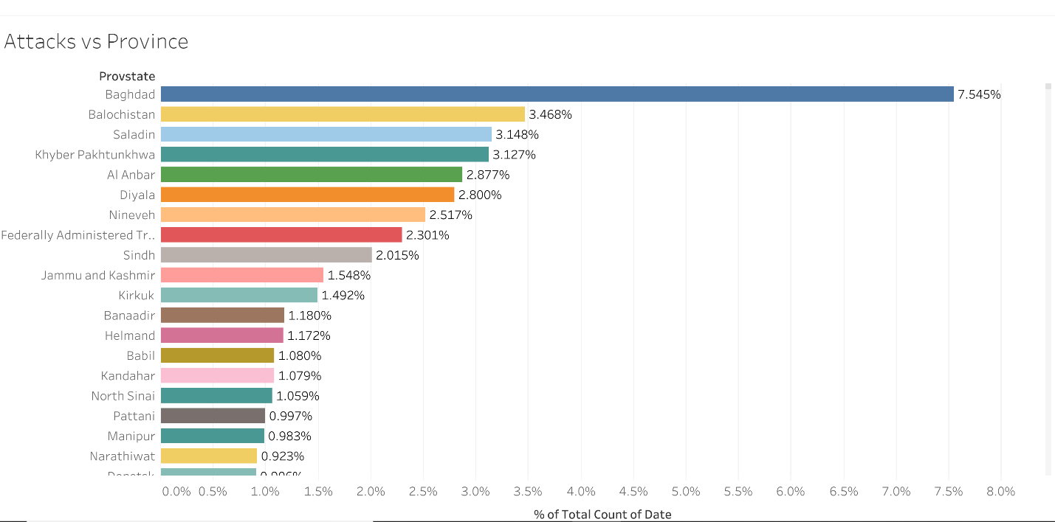
Province vs Attacks – Past Data (Tableau)

Slide 20
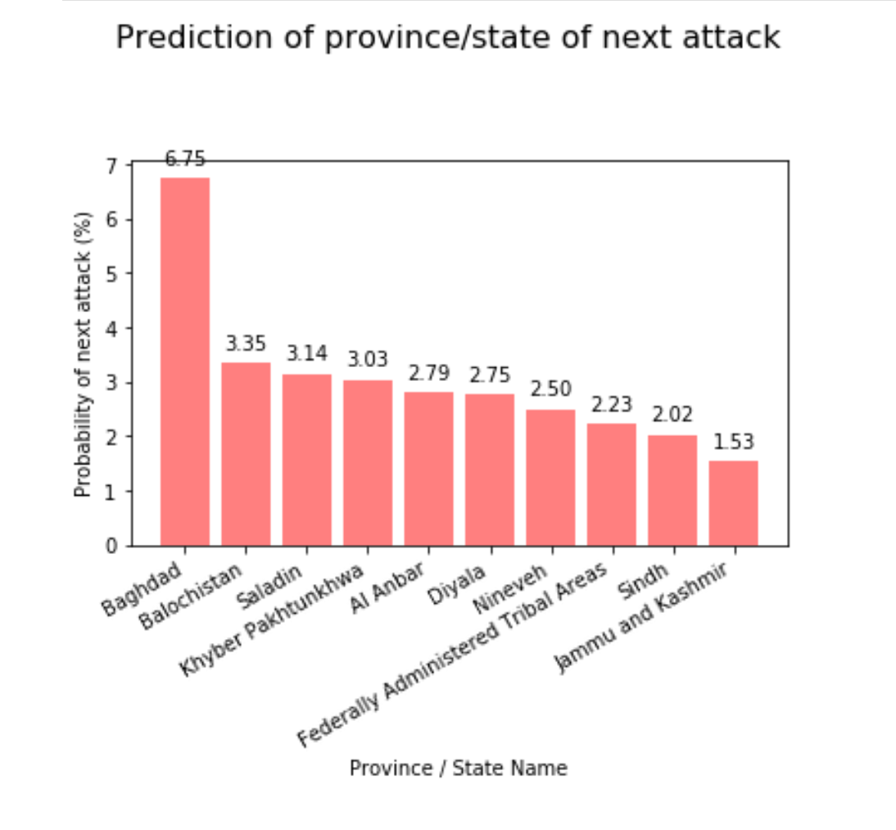
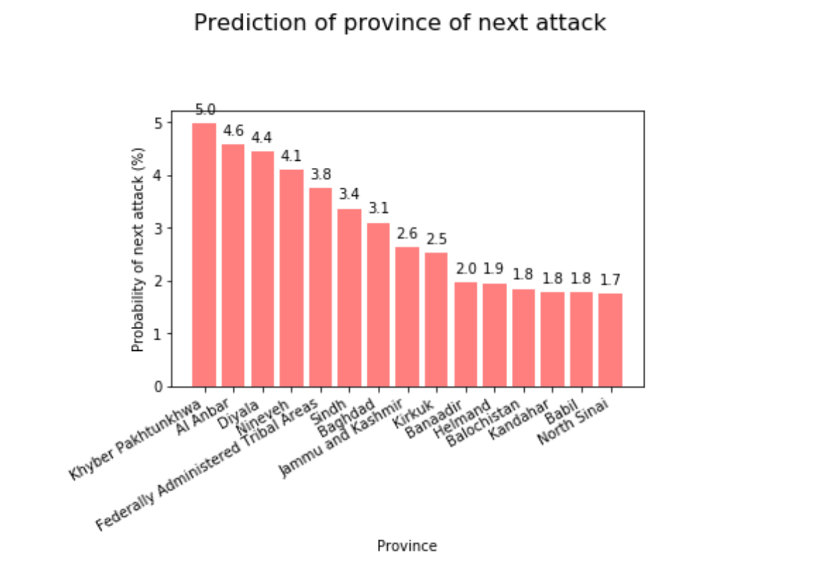
Province vs Attacks Prediction - Bar
Deep Learning – 100%
Random Forest – 99.01%
We also did predictions on top provinces predicted for next attack. There were 1925 provinces. For the Deep Learning model, due to issues with time taken we filtered provinces with attacks >= 50 and the prediction was done for top 235 provinces.

Slide 21
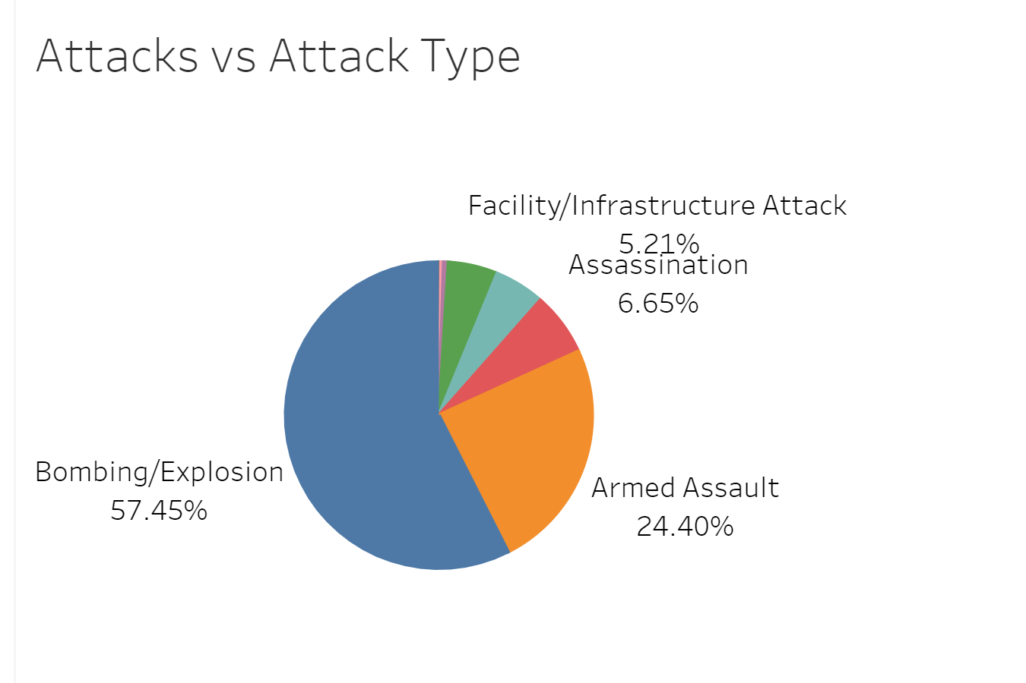
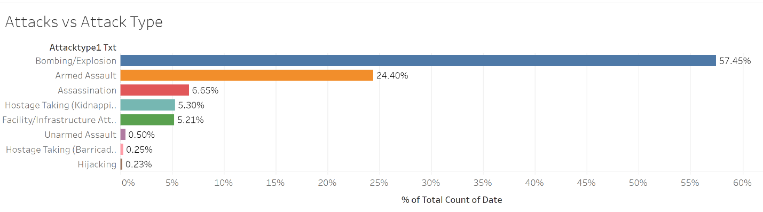
AttackType vs Attacks – Tableau (Past Data)

Slide 22
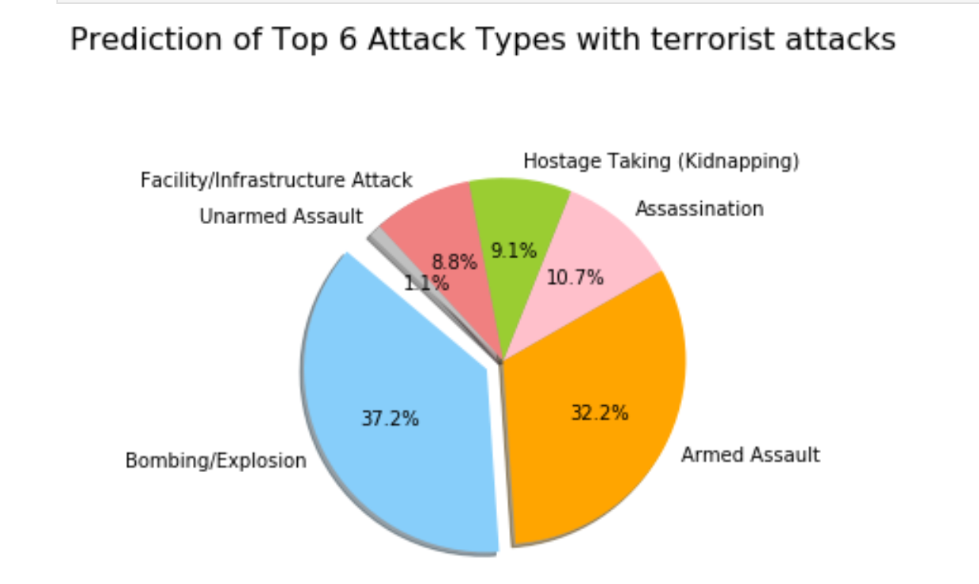
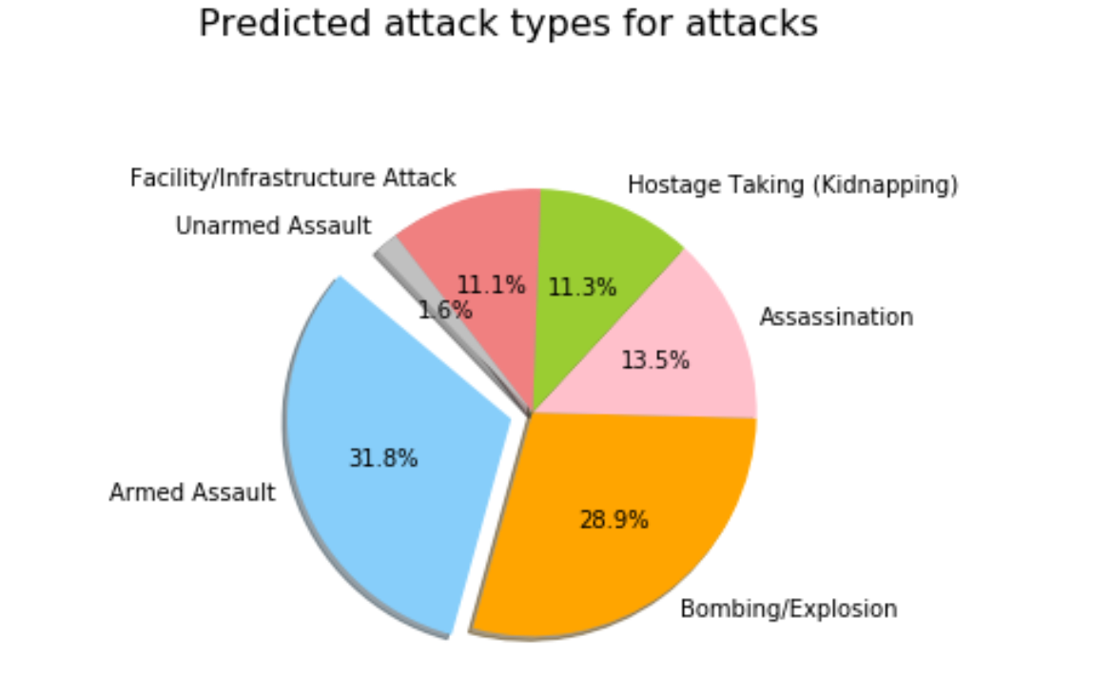
AttackType vs Attacks Prediction
Random Forest – 100%
Deep Learning – 100%
We filtered the attack type “Unknown” and the prediction was run for 6 attack types. Interestingly, although in past “Bombing / Explosion” had > 57% attacks, the machine learning predicts rise in “Armed Assault”.
Deep Learning even shows that it will become the top attack type.

Slide 23
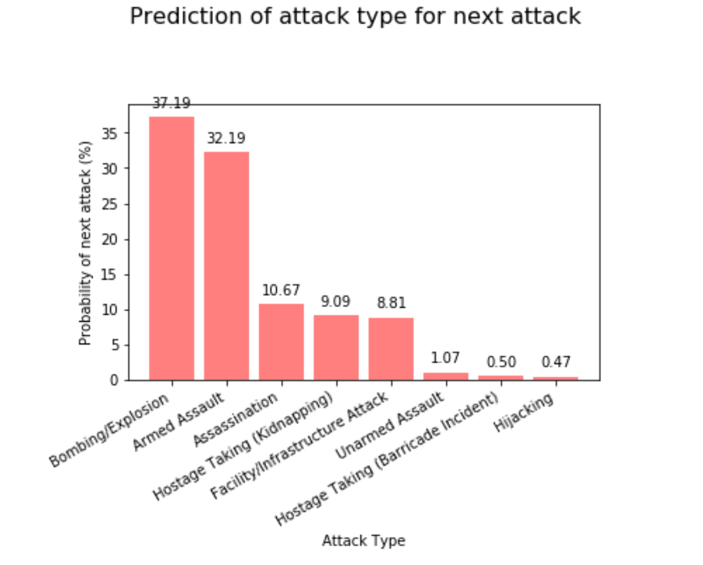
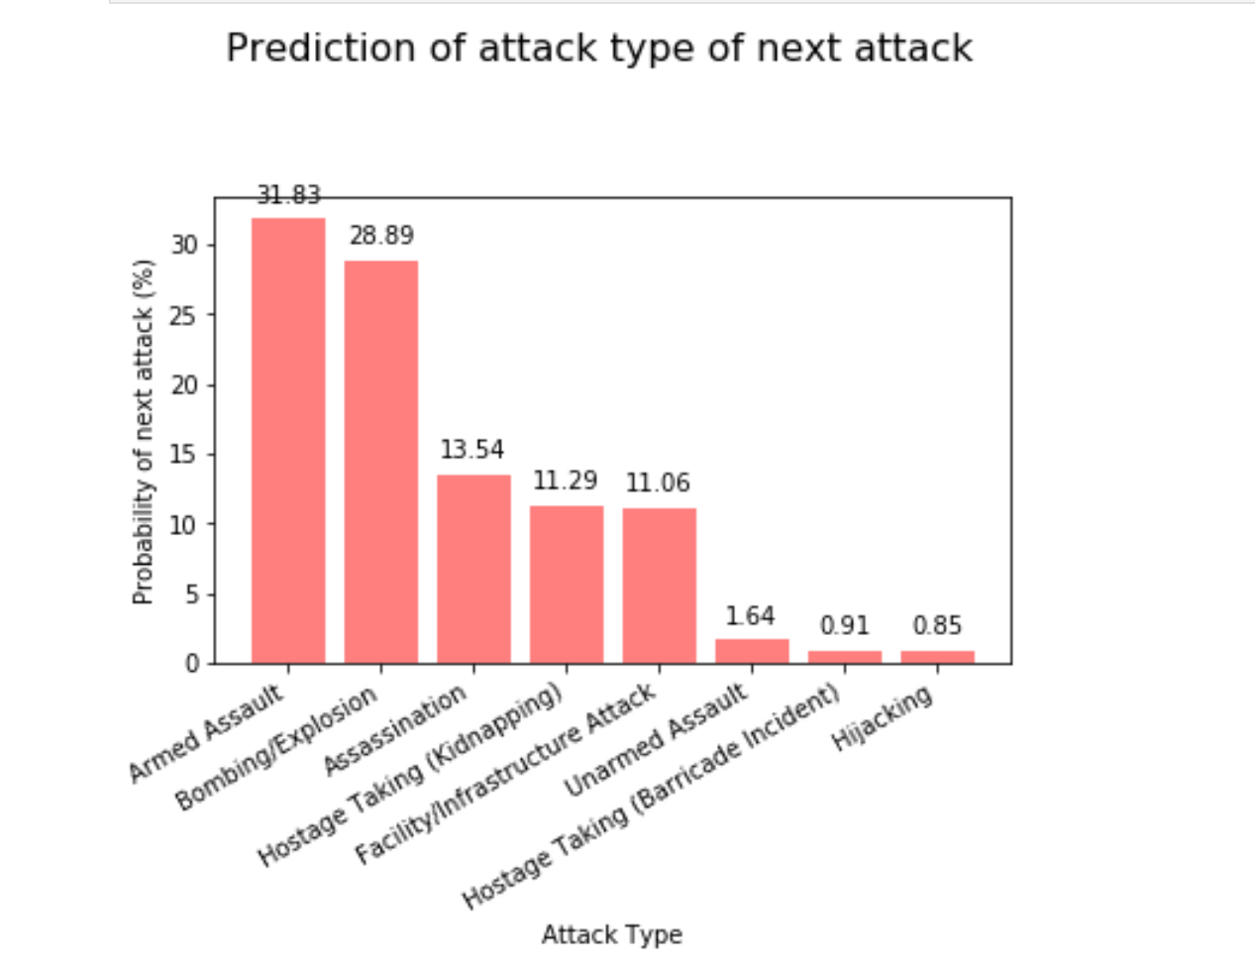
AttackType vs Attacks Prediction - Bar
Random Forest
Deep Learning

Slide 24
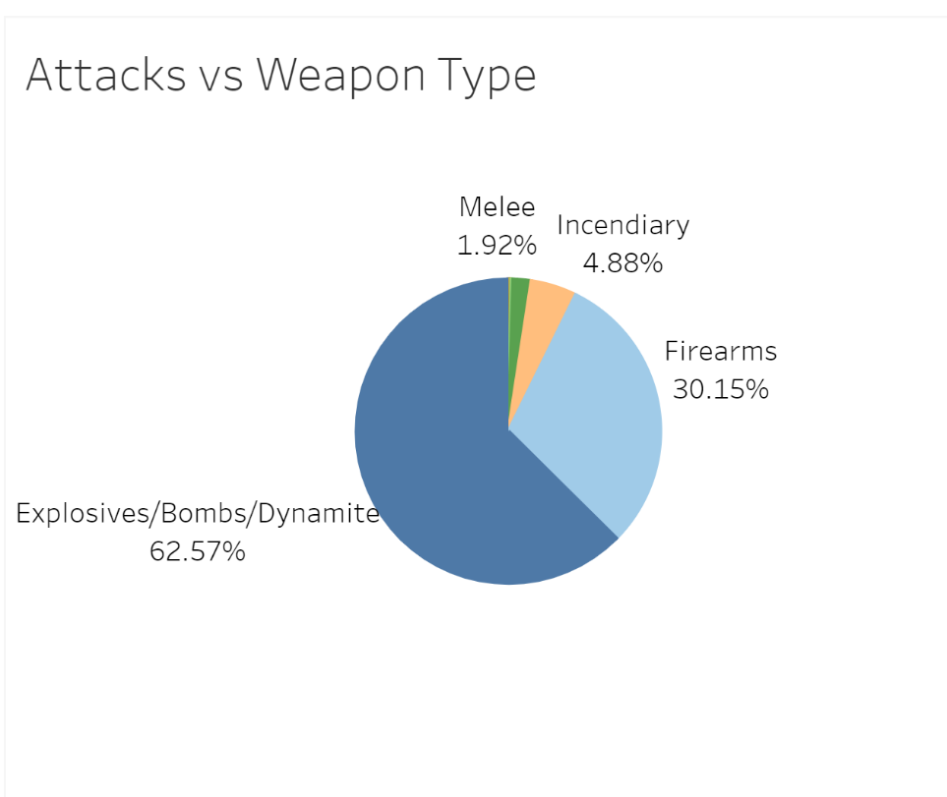
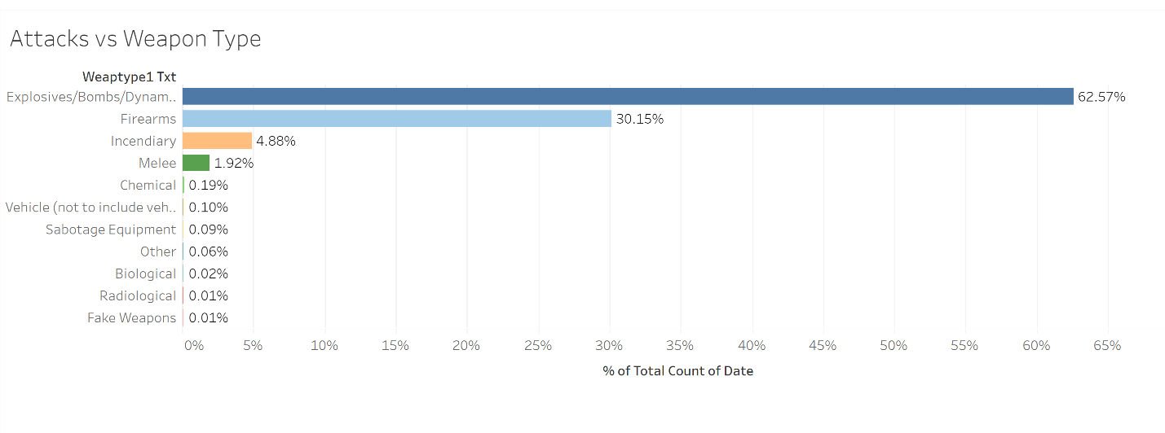
WeaponType vs Attacks – Tableau (Past Data)

Slide 25
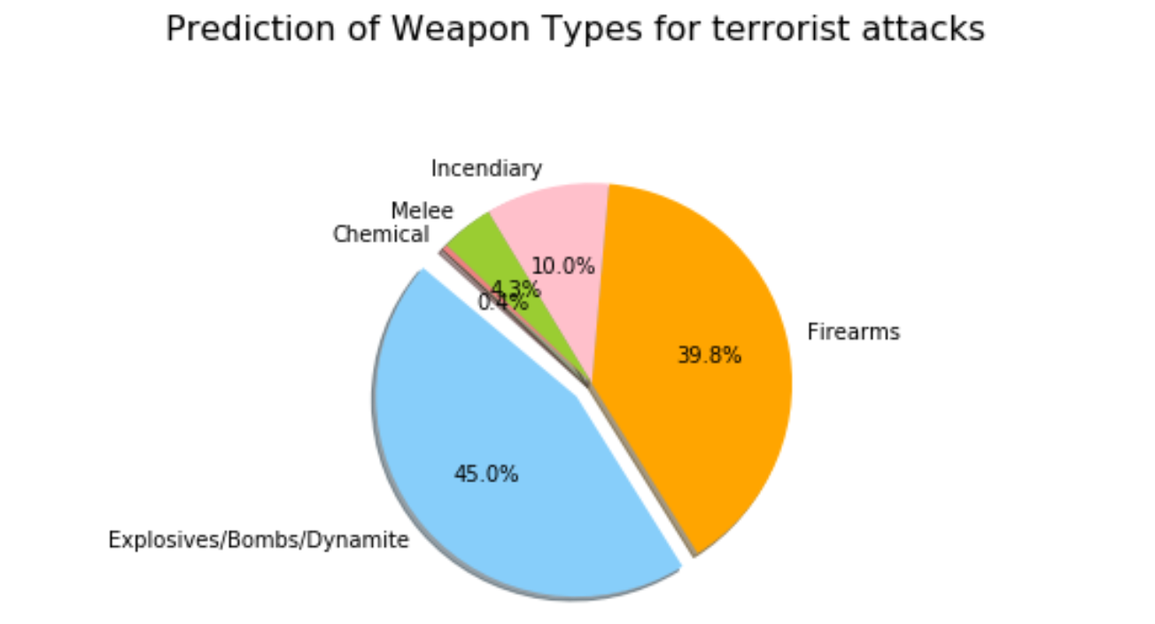
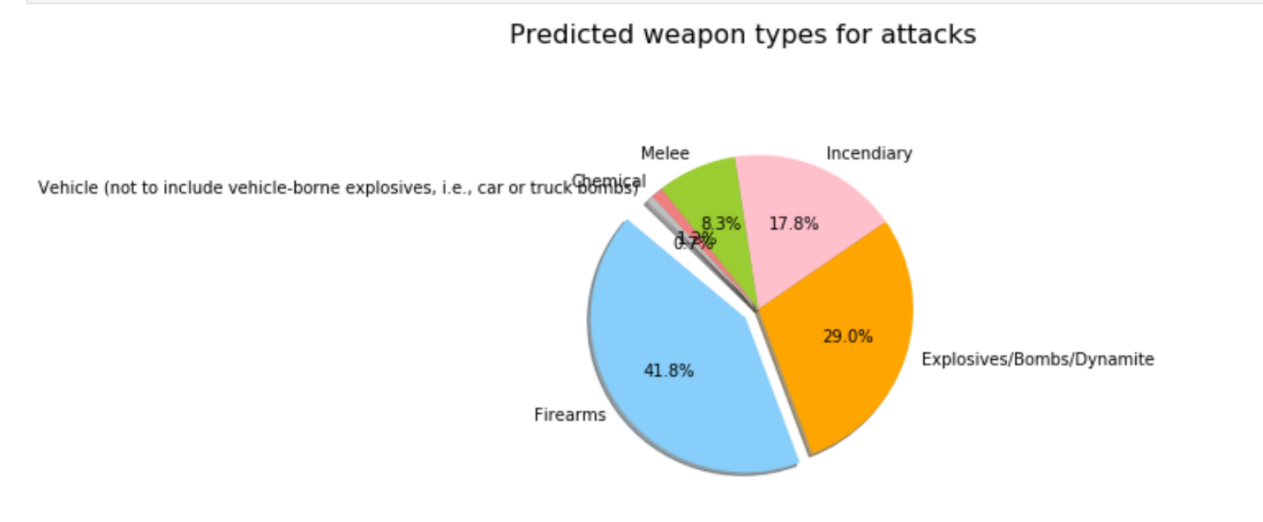
WeaponType vs Attacks Prediction
Random Forest – 100%
Deep Learning – 99.85%
For the weapon type also, in past, “Explosives/Bombs/Dynamite” were > 62.5%. But Machine learning predicts that this percentage goes down significantly and “Firearms”, “Incendiary”, “Melee” are showing significant rise.
Deep Learning predicts “Firearms” to be top weapon type in future at 41.8%.

Slide 26
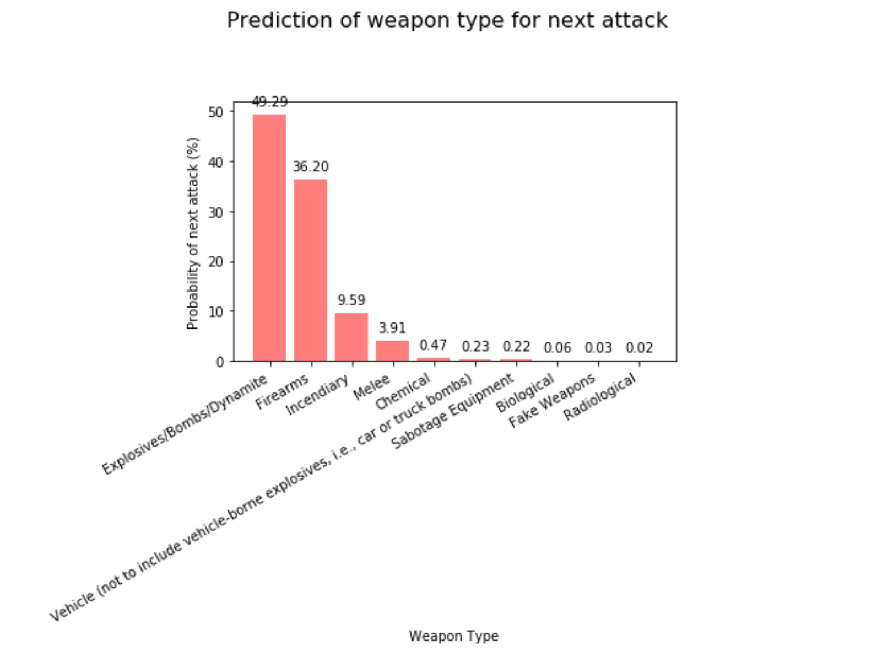
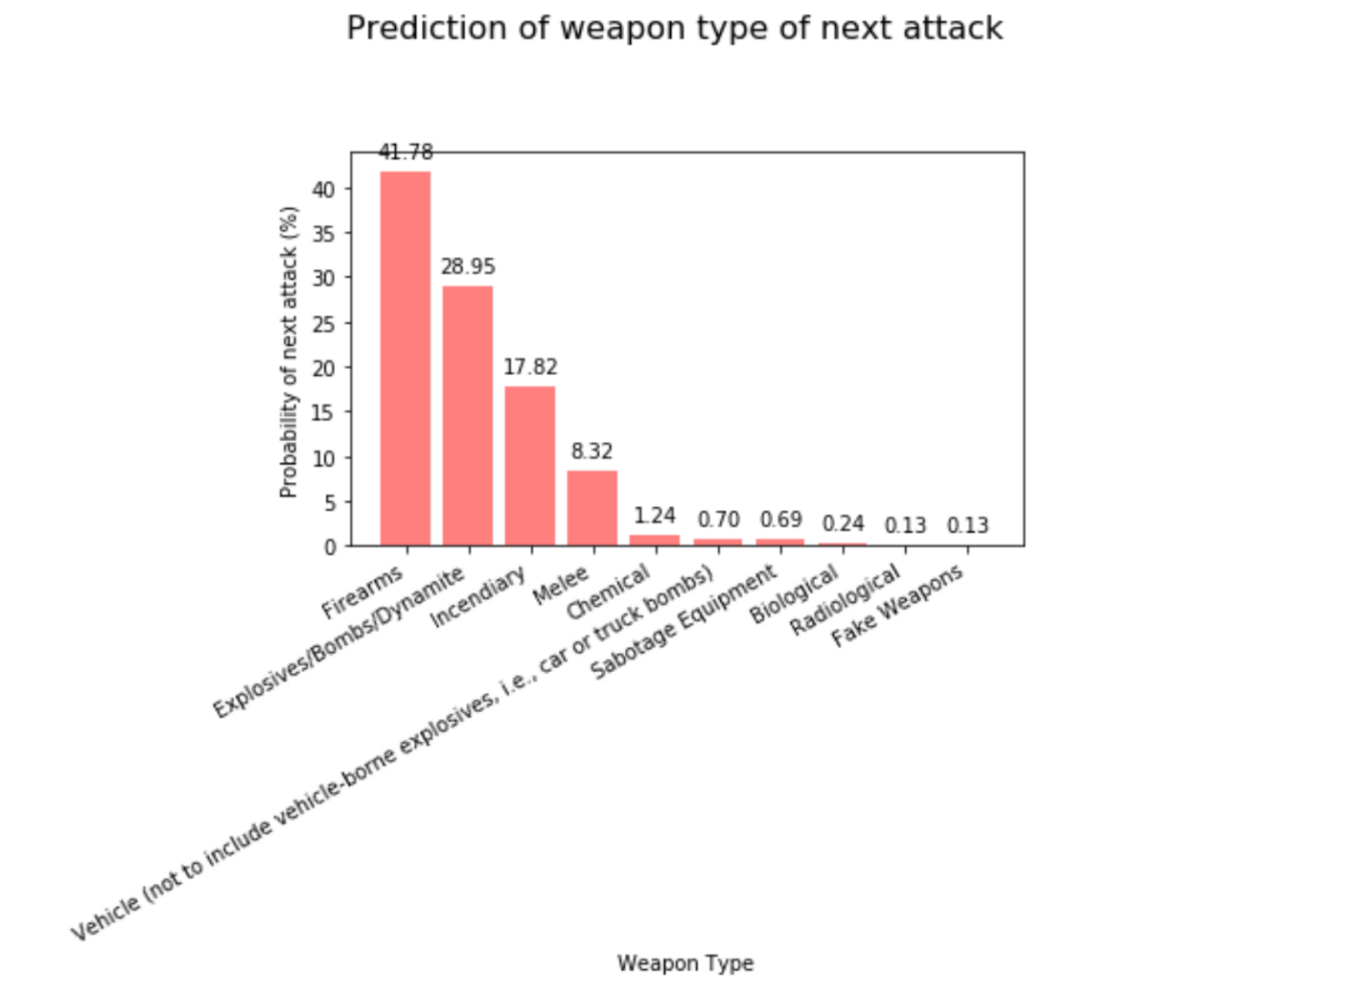
WeaponType vs Attacks - Bar
Random Forest
Deep Learning

